Slide 1
Designing WCF Services

Slide 2
Tim Rayburn
Principal Consultant with Improving Enterprises
Author of Entity Framework 4.1 : Expert’s Cookbook
Microsoft MVP for Connected Systems Development
Founder & Organizer of Dallas TechFest
Blog: TimRayburn.net
Email: Tim@TimRayburn.net

Slide 3
Devlin Liles
Principal Consultant with Improving Enterprises
Author of Entity Framework 4.1 : Expert’s Cookbook
Microsoft MVP for C#
Team Foundation Server & Agile Guru
Blog: DevlinLiles.com
Email: Devlin@DevlinLiles.com

Slide 4
What is WCF?
Windows Communication Foundation provides abstractions over:
Security
Metadata
Protocol
And other service behaviors

Slide 5
The ABC’s of WCF
Address
Binding
Contract
Endpoint

Slide 6
DEMO
WCF Basics

Slide 7
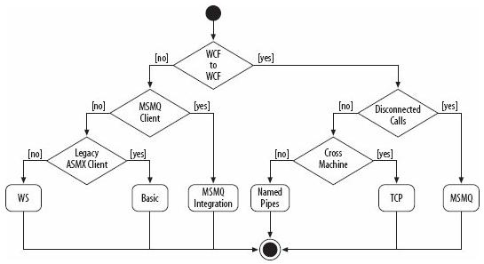
Which Binding To Use?
Image from “Programming WCF Services” by Juval Lowy

Slide 8
Tim’s Rules (SOAP)
Services should take 1 parameter, which should be a DataContract not a .NET type.
This type should be named <Operation>Request
Services should return a DataContract, not a .NET type.
This type should be named <Operation>Response
Choose your operation names carefully, and always assign them namespaces.

Slide 9
What breaks WSDL?
Changing operation name
Changing the number of parameters
Changing the type name of parameter or response
Changing the namespace of operation or types

Slide 10
What does NOT break WSDL?
Adding operations to an existing service
Adding members to an existing data type
Removing non-required members for an existing data type.
Changing URL
This will require re-config of your clients, but will not break proxies.

Slide 11
DEMO
Config via Code

Slide 12
Wait … You don’t use Console apps in production?

Slide 13
DEMO
Hosting in IIS

Slide 14
Inversion of Control

Slide 15
DEMO
Inversion of Control

Slide 16
SOAP vs. REST

Slide 17
DEMO
jQuery

Slide 18
Get The Source & Slides
https://github.com/trayburn/Presentations.WcfTopics

